Slide 1
Demo 4 – PinPoint App
Thomas More – 29 dec. 2023

Slide 2
Agenda
Action plan – last demo
Scope
Adding new events
See the details of events
Searching & saving events
View contacts
Add new contacts
Next Steps

Slide 3
Action plan last demo
Short term – In progress
Unique friend codes
User location on map
Importing custom floorplan
Floorplan overview

Slide 4
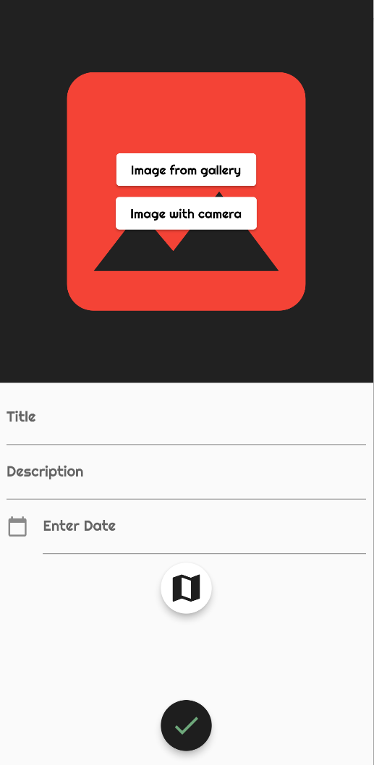
Scope – Adding new events
Admin only
Floorplans -> Whole event
Floorplans part of event
Overview of events

Slide 5
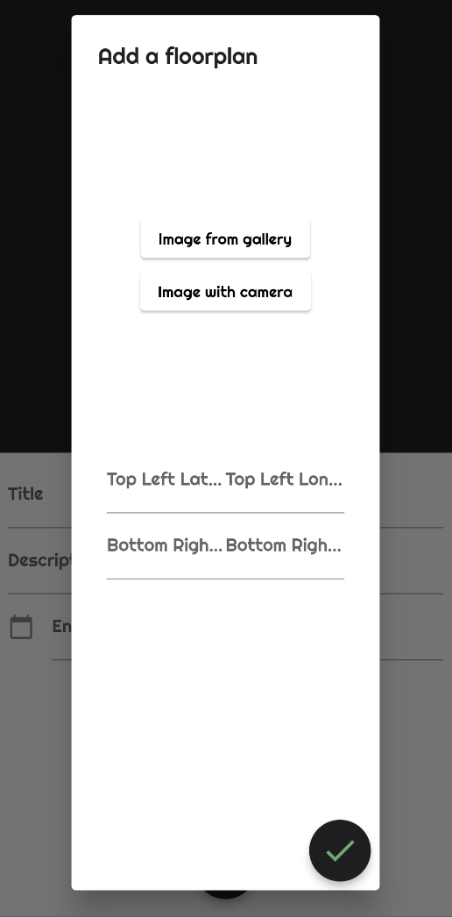
Details of an event
All the information you need
Title
Description
Start date & end date
Floorplan

Slide 6
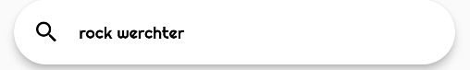
Scope – Searching & saving events
Events you’re interested in
Find events you like
Save them

Slide 7
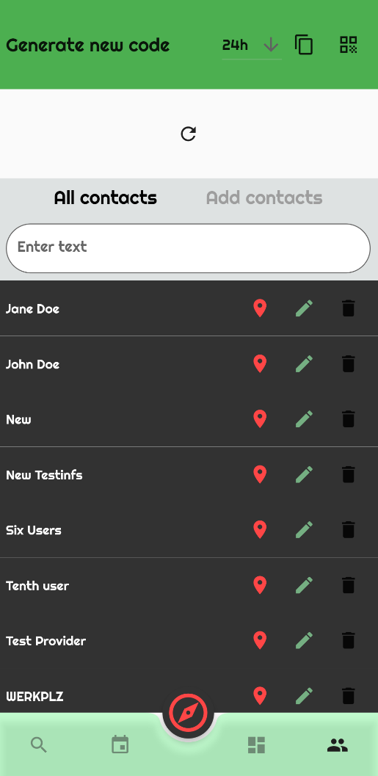
Scope – View contacts
An overview of all your contacts
View all your contacts
Locate, edit & delete

Slide 8
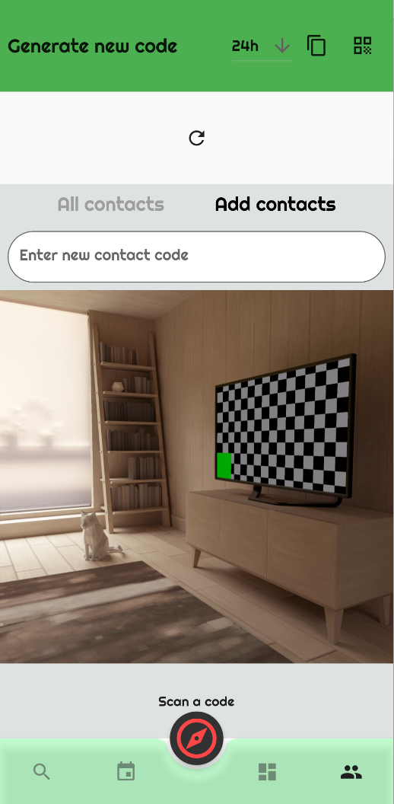
Scope – Add new contacts
New friends
Field to enter unique code
Camera opens automatically for QR

Slide 9
Summary
Adding, searching & saving events
Viewing & adding new contacts

Slide 10
Next steps
Last sprint
Back-end modifications for contact relations
Finetuning lay-out (splashscreen, design, ...)
Finetuning code (searching for & solving bugs)

Slide 11
Thank you
Any questions?

